Slide 1

The Illinois Forestry Development Council and Illinois Forest Management

Slide 2
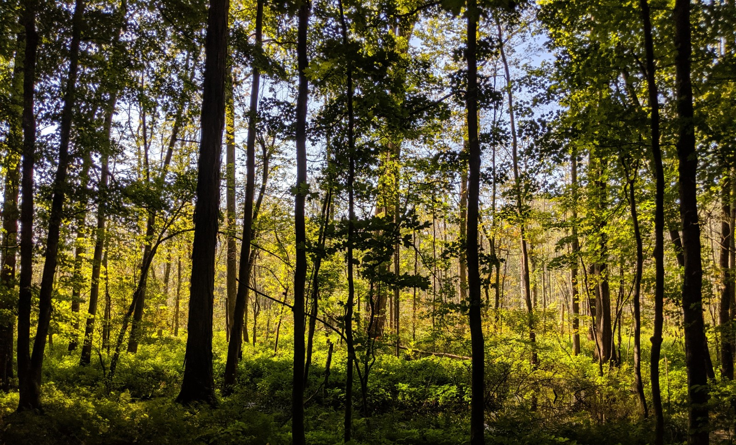
The Illinois Forestry Development Council
The Council was created in 1983 upon passage of the Forestry Development Act ( 525 ILCS 15).
The 29 members represent woodland owners, farmers, forest/wood products industry, urban forestry, environmental concerns, state and federal agencies, the General Assembly, and the Governor’s office.

Slide 3
The Illinois Forestry Development Council
The Council’s purpose is to identify and evaluate the social, economic, scientific, and educational value of Illinois’ forest lands and forest products industries.
The council determines:
1.) Magnitude, nature, extent, and ownership of Illinois’ forest resources
2.) Uses, benefits, and ecosystem services our forest resources provide
3.) Economic development, increasing employment
4.) Staffing and funding needs for state-wide forestry programs and support
5.) Forestry education and outreach programs
6.) Soil, water, and wildlife habitat benefits of forestry practices

Slide 4
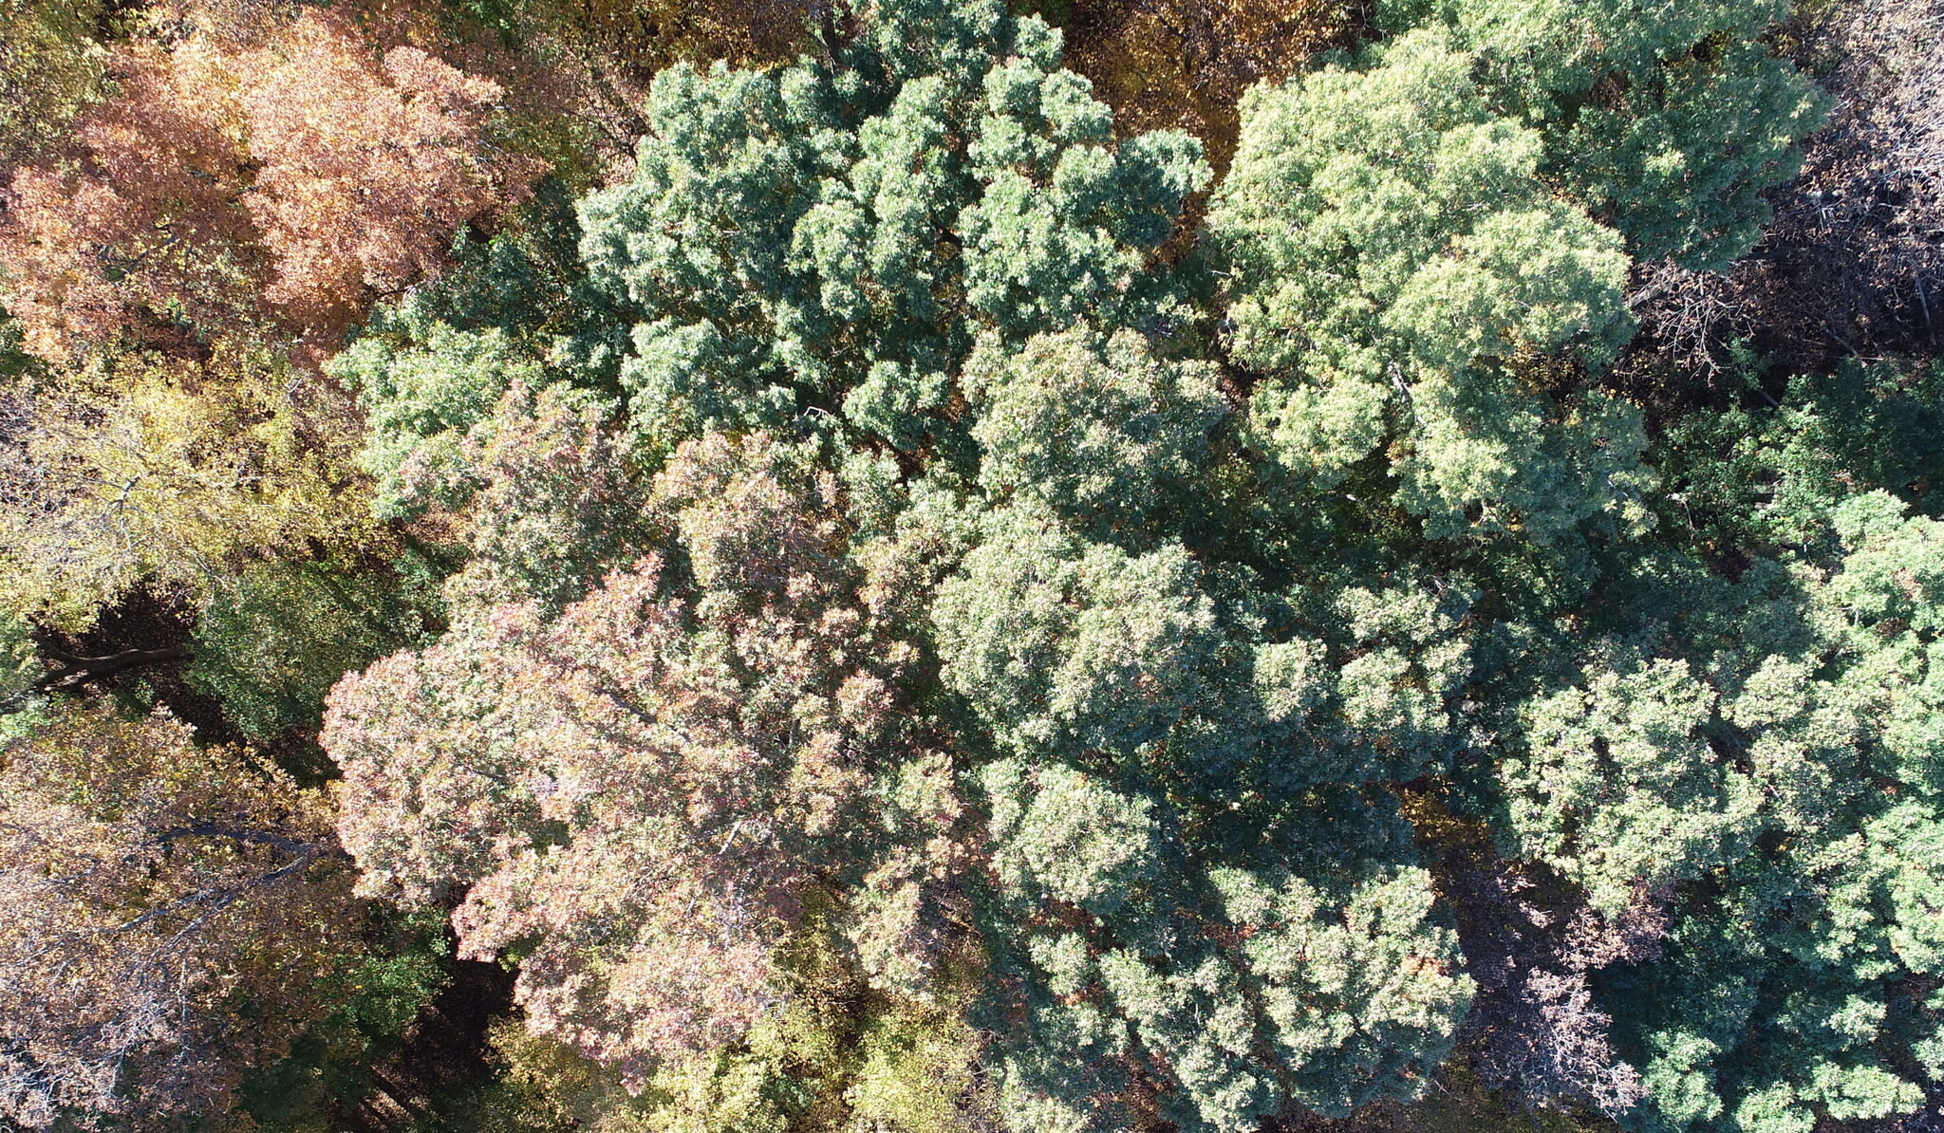
Threats to Forest Lands and Resources in Illinois
Seven Threats to Illinois Forests Identified by the IFDC
1.) Diminishing Oak-hickory Dominant Forests
2.) Fragmentation of Large Forest Areas
3.) Forest Health Threats are Increasing
4.) Forestry Professionals are too Few
5.) Forest Industries and Mills are Shrinking
6.) Urban and Community Forests Face Extreme Pressures and Challenges
7.) Forestry Funding and Significant Other Threats

Slide 5
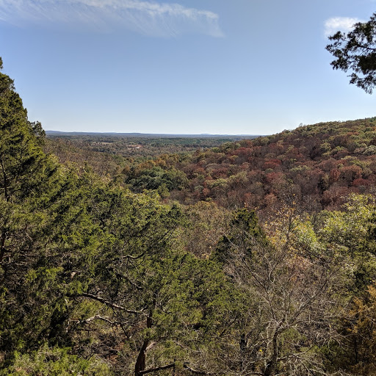
History of Illinois Forests
Forestland prior to European settlement – 13.8 million acres
Forestland today – 4.4 million acres
Original forests cleared for agriculture, fuelwood, fence posts, transportation, and urban and industrial development

Slide 6
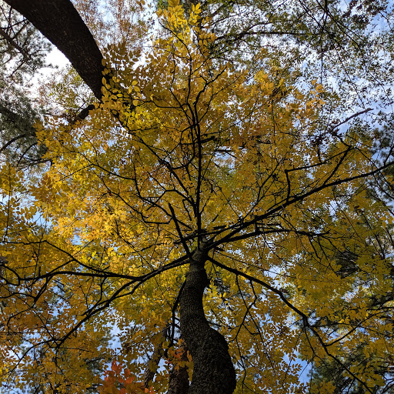
Illinois Forests Today
97% of Illinois’ forests are classified as hardwoods (3% conifers)
Forest cover types include: Oak-hickory (53%), elm-ash-cottonwood (22%), maple-beech (20%), misc. pine (3%), and oak-gum-cypress (2%)
Over 250 tree species have been recorded in Illinois
Twenty native species of Oak
Ten native species of hickory
Five native species of ash

Slide 7
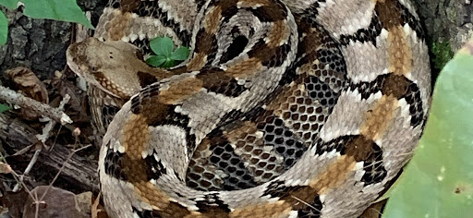
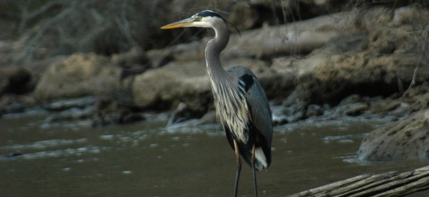
Illinois Forests’ Impact on Wildlife
75% of Illinois’ native wildlife species rely on forest habitat for a portion of their life cycle
Provides habitat for over 420 vertebrate species
Over 120 bird species utilize Illinois forests for nesting

Slide 8
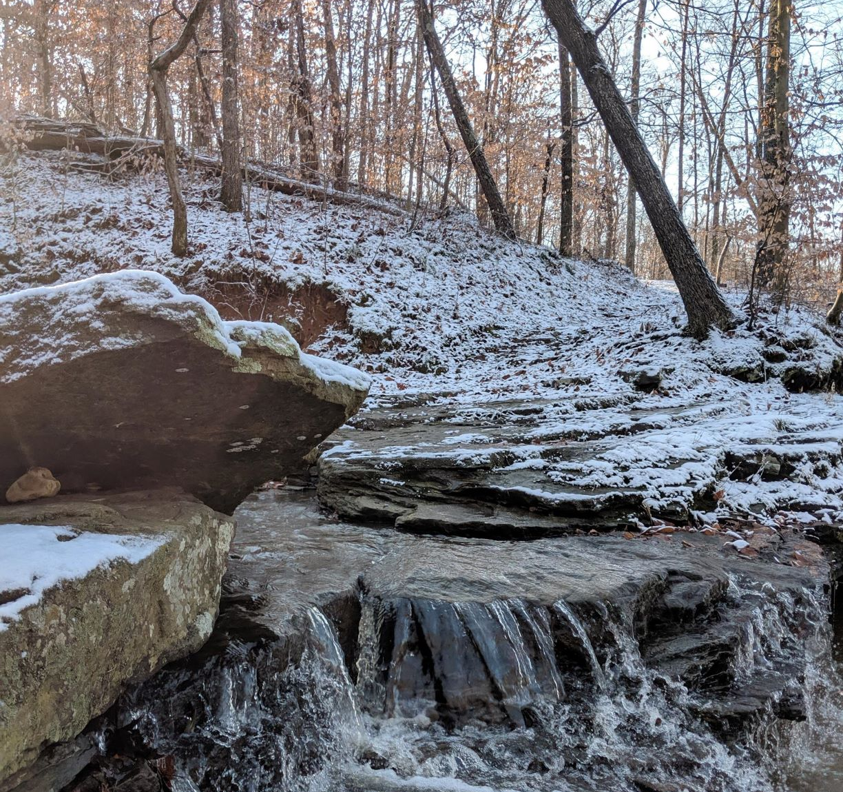
Environmental Benefits of Illinois Forests
Carbon sequestration through photosynthesis – a process that removes carbon from the atmosphere and stores that carbon throughout the trees physiological feature (leaves, branches, roots)
Purify air from other atmospheric pollutants
Help reduce water pollutants by filtering nitrogen, phosphorous, and other pollutants before they reach streams, rivers, lakes, and the Gulf of Mexico

Slide 9
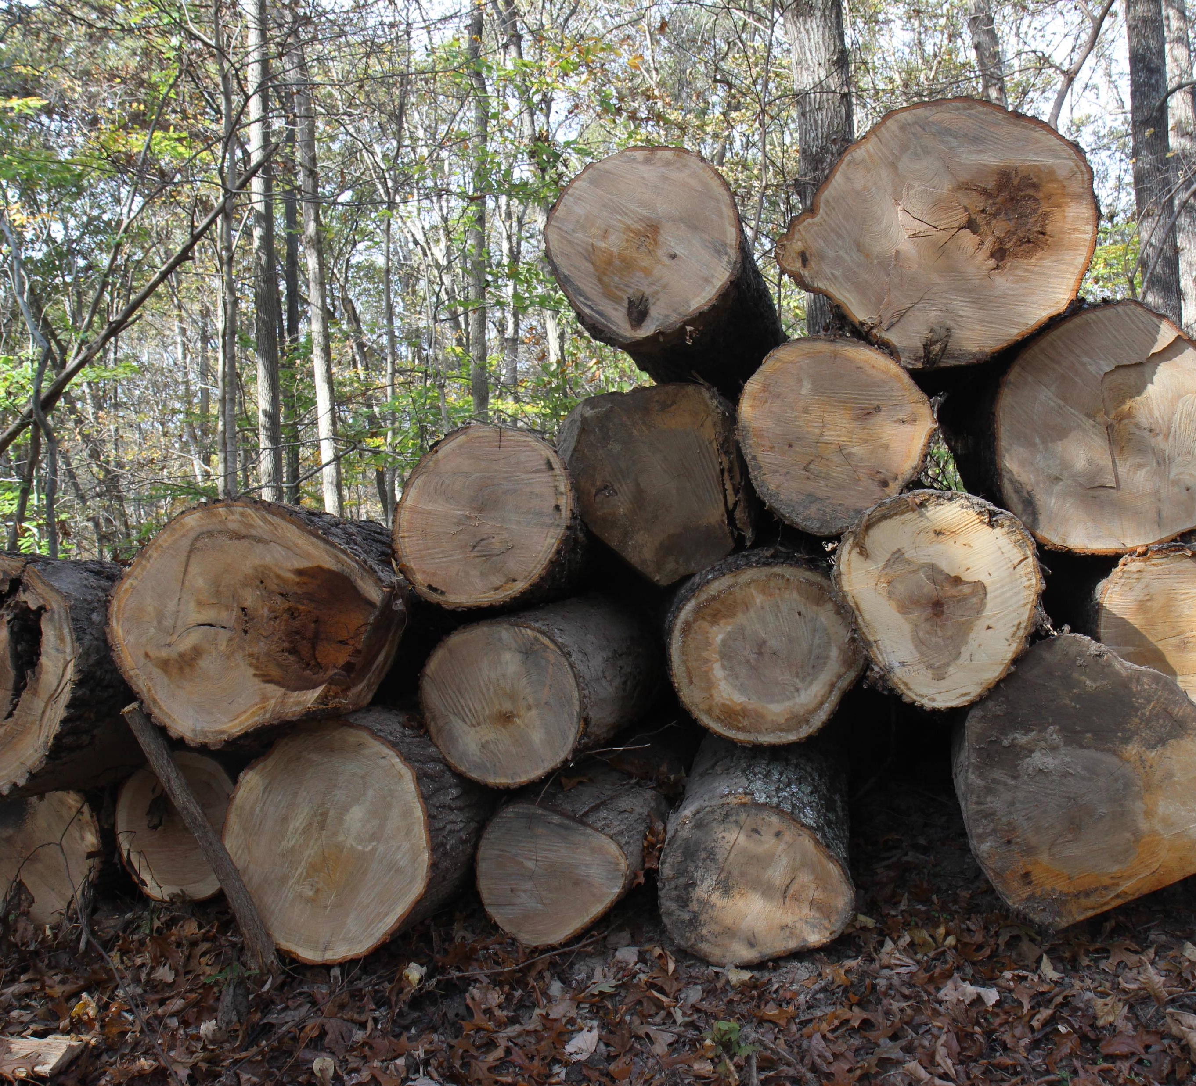
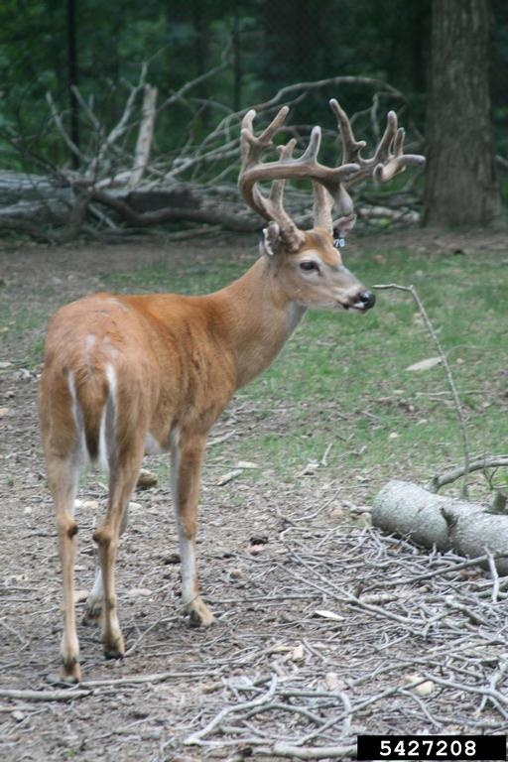
Threatened Oak-hickory Dominant Forests
Oak/hickory forest are the predominant forest type in Illinois
The broad range of tree species in this forest type ensure optimal biological diversity
Home to a number of mast-producing trees (nut-producing) that provide crucial food and habitat for wildlife
Species in this forest type are important to the timber industry

Slide 10
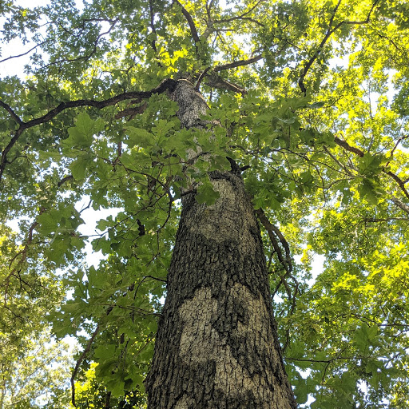
Importance of Disturbance in Oak-hickory Forest
Oaks respond well to natural disturbances (fire, wind, ice, tornadoes)
Decreases in the frequency of beneficial disturbances like fire and thinning have contributed to suppression of oak seedlings and an increase in abundance of non-oak seedlings
Oaks require light and space to grow into the canopy
Without ample light and space, oaks are outcompeted by shade-tolerant species such as sugar maple/beech
Forest management techniques used today mimic natural disturbance in forests

Slide 11
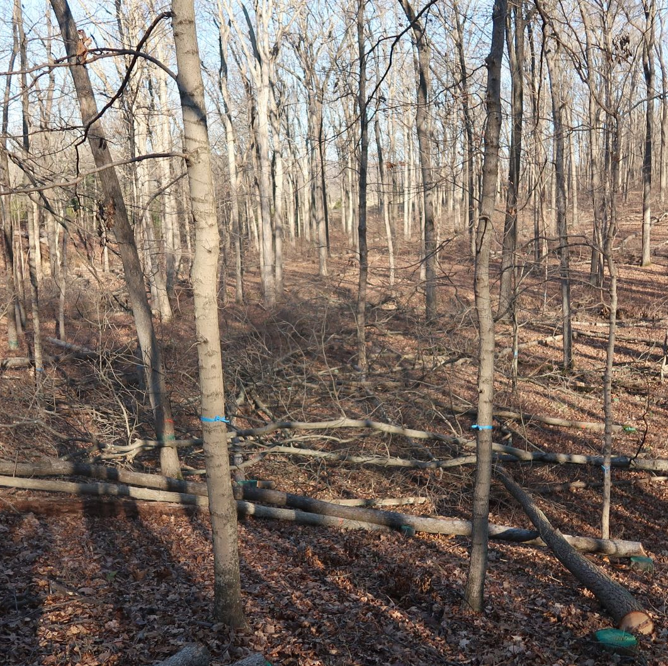
Thinning in Oak-hickory Forest
Forest Stand Improvement (FSI) is the technique of thinning the amount of trees in a forested area
Less desirable species and competitors of oaks are removed from the forest canopy
Strategically removing species such as sugar maple, beech, elm etc.
Opens canopy to allow sunlight through the forest canopy
Helps establish oak seedlings, and releases existing suppressed oaks
Image Description: A thinned canopy after Forest Stand Improvement (FSI) management.

Slide 12
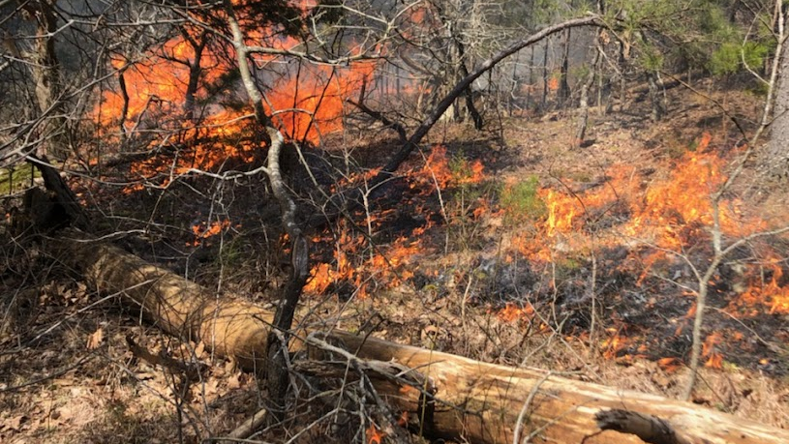
Prescribed Fire in Oak-hickory Forests
Introducing controlled fire to a forest reduces midstory and forest floor vegetation
Helps reduce shading and oak competition
Reduces soil surface moisture which can discourage establishment of oak competitors
Should always be conducted with the planning and oversight of a professional forester
Image Description: A successful prescribed burn carrying through the forest understory.

Slide 13
Fragmentation of Forested Areas
Illinois’ forestland predominantly held by private landowners
An estimated 3.5 million acres privately owned (77% of Illinois forest)
Harmful consequences of fragmentation include a loss of biodiversity, increased populations of non-native species, and changes in living organisms and environmental conditions
Process accelerated when more and more people seek to purchase land
Increasing need for responsible forest management in privately owned forest

Slide 14
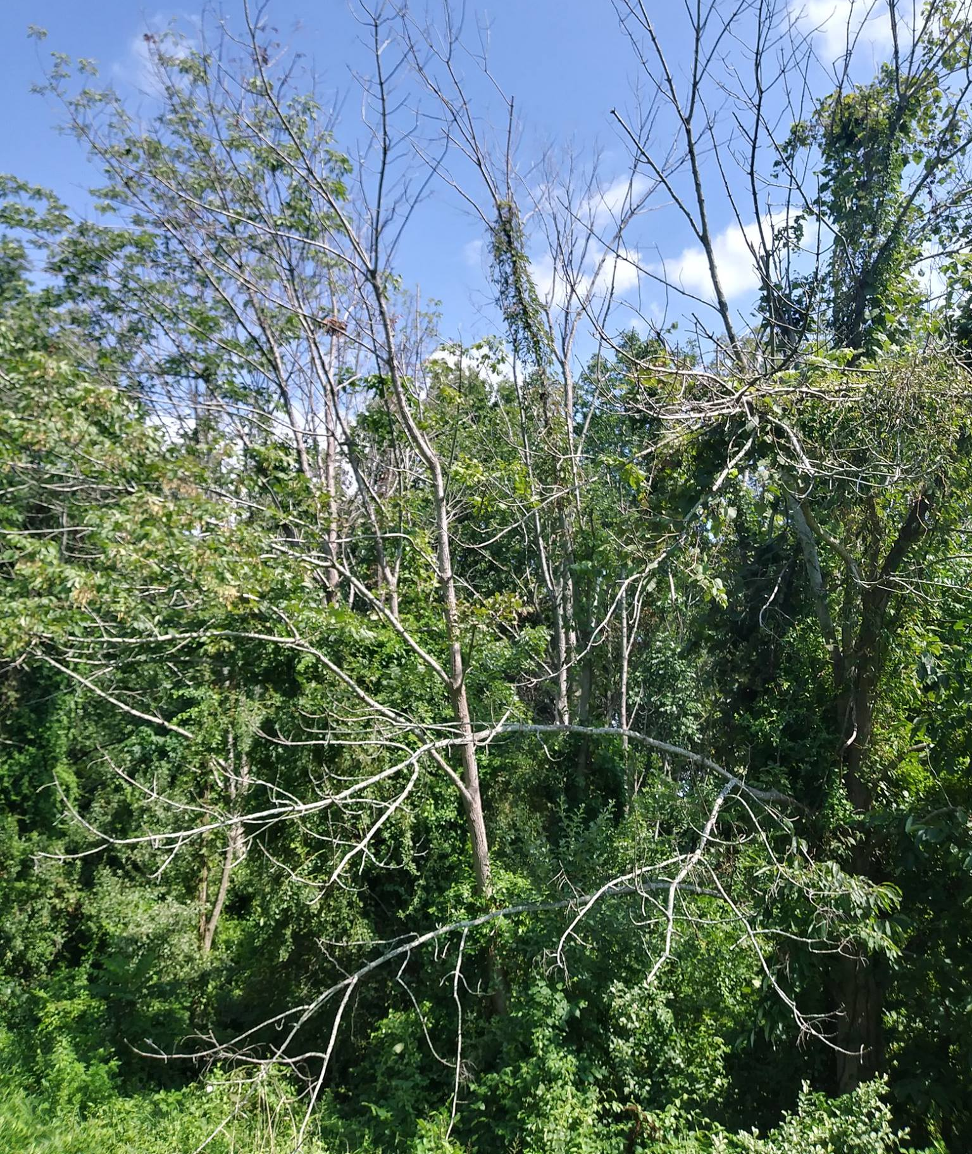
Forest Health Threats are Increasing
Multiple factors affect forest health:
1.) exotic invasive plants
2.) insects
3.) pathogens
Damage from floods, ice storms, wind or livestock grazing without remediation, are also examples of forest health issues
Left Picture: An ash stand showing considerable decline as a result of emerald ash borer.
Image Description: An ash stand showing considerable decline as a result of emerald ash borer.

Slide 15
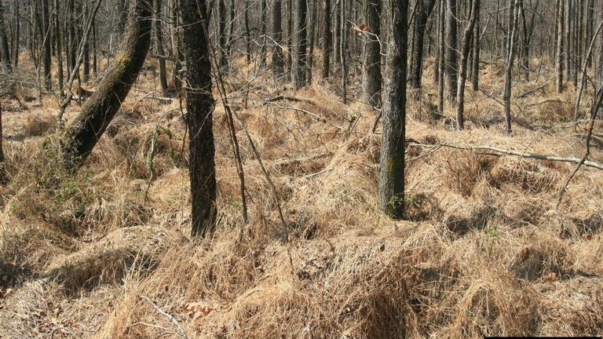
Forest Health Threats: Non-native Invasive Species
Any plant, animal, or organism outside its’ native range that causes significant injury to displace or kill native species
Control involves positively identifying the invasive species followed by eradication of that species
Image Description: A thick carpet of Japansese stiltgrass, a non-native invasive plant in Illinois.

Slide 16
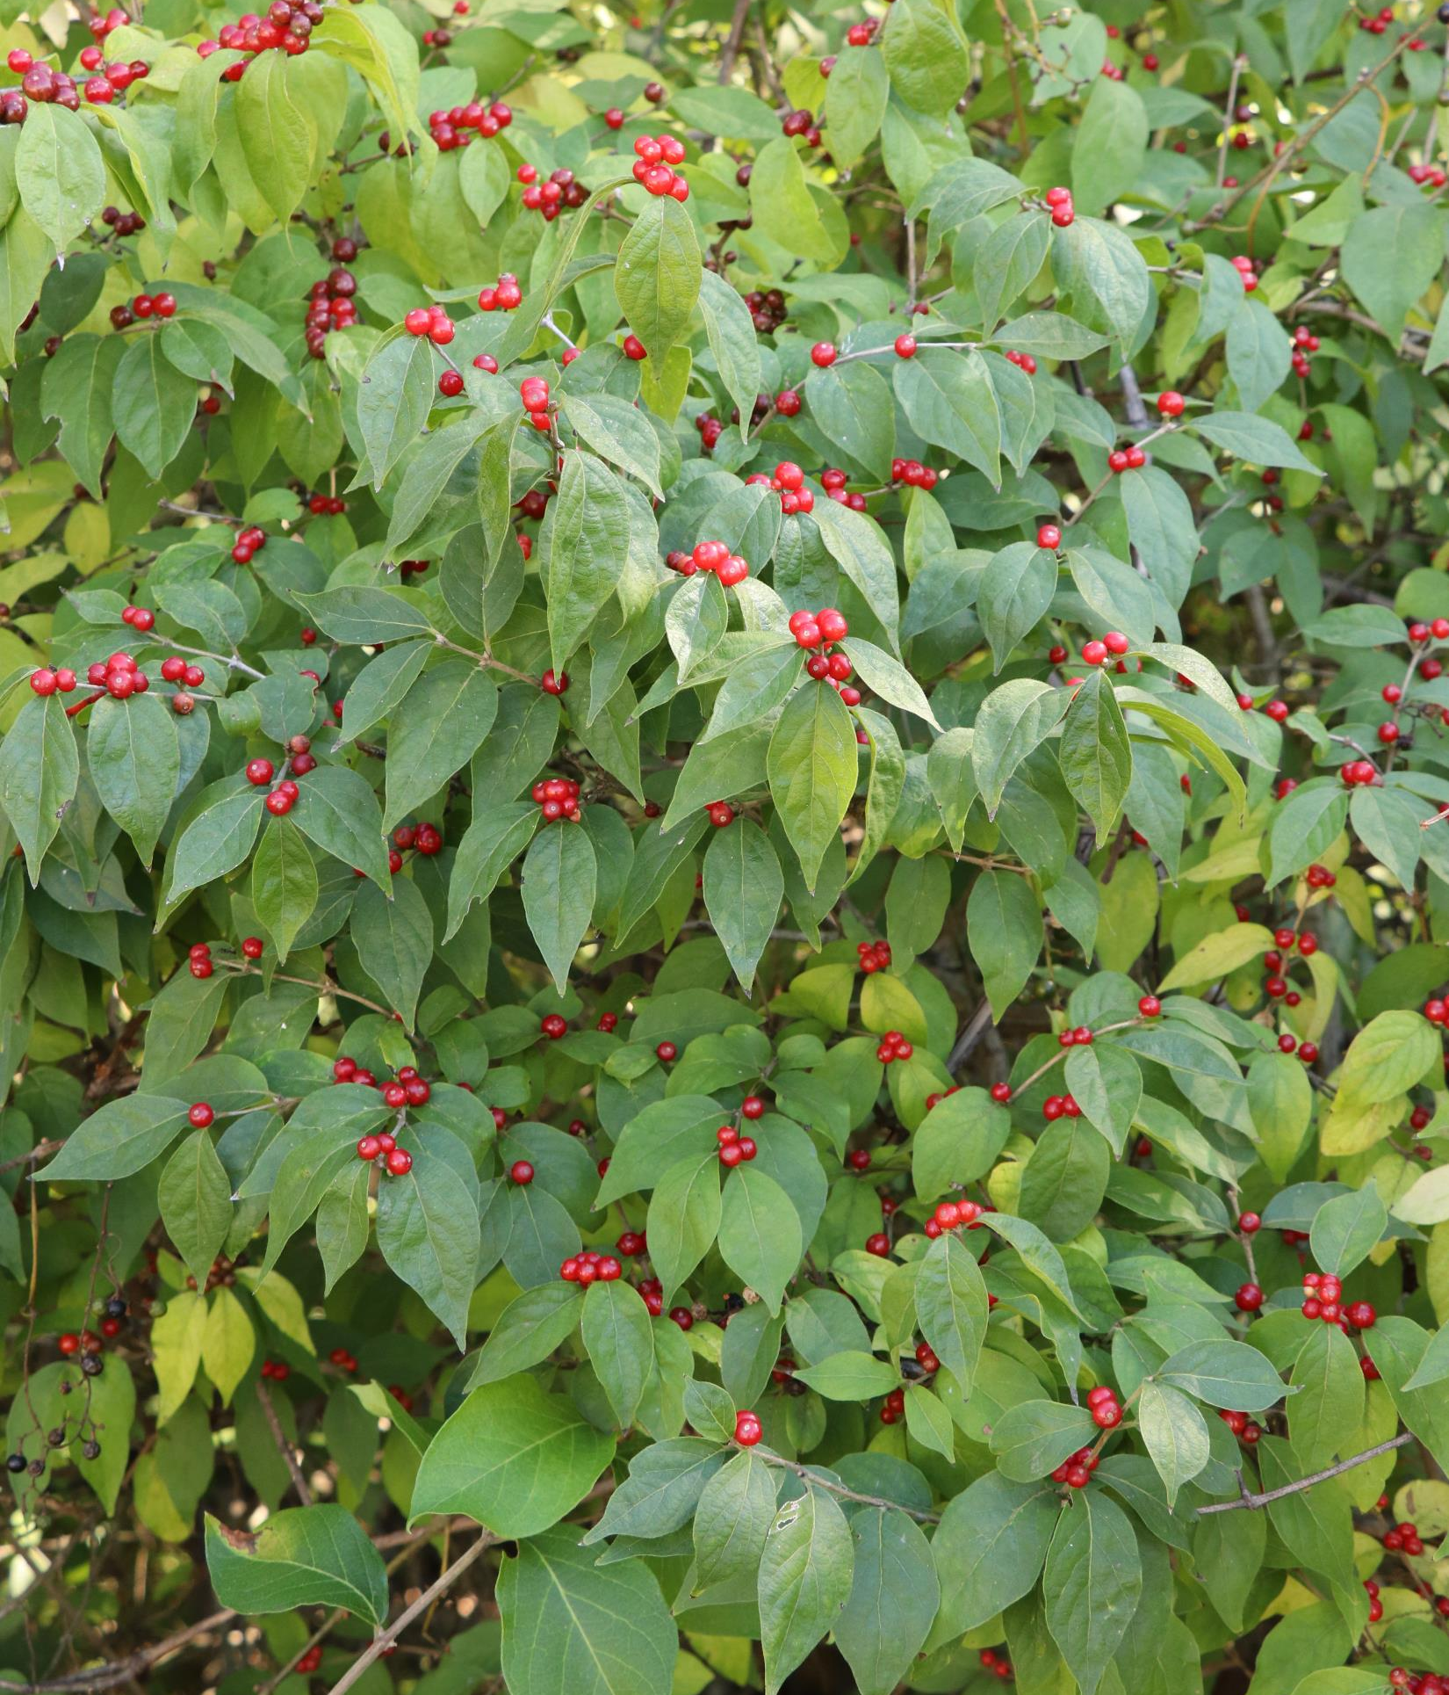
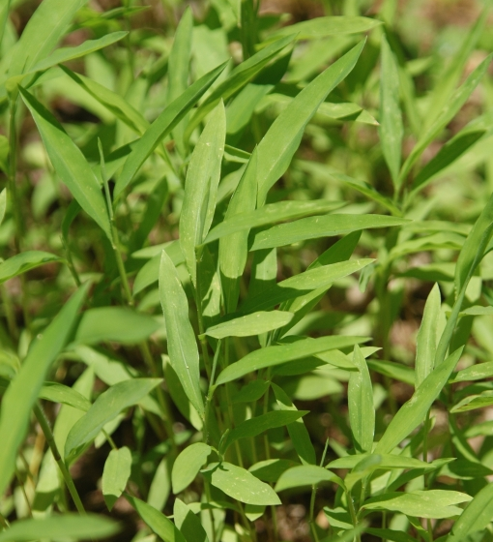
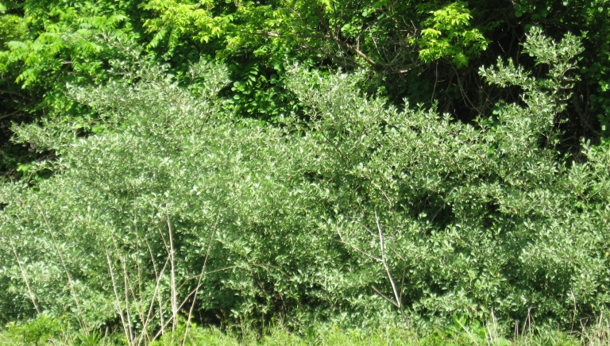
Forest Health Threats: Non-native Invasive Plants
(Top Left) – Amur honeysuckle
(Top Right) – Japanese stilt grass
(Bottom) – Autumn Olive

Slide 17
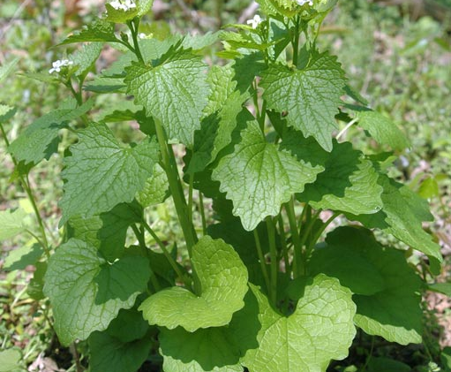
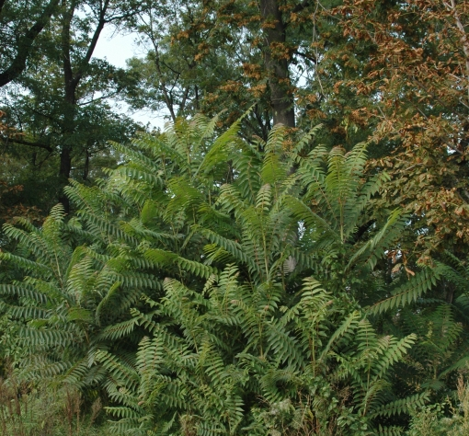
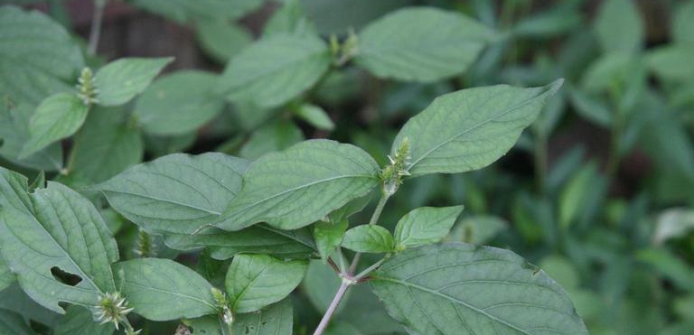
Forest Health Threats: Non-native Invasive Plants
(Top Left) - Garlic mustard
(Top Right) - Tree of heaven
(Bottom) – Japanese chaff flower

Slide 18
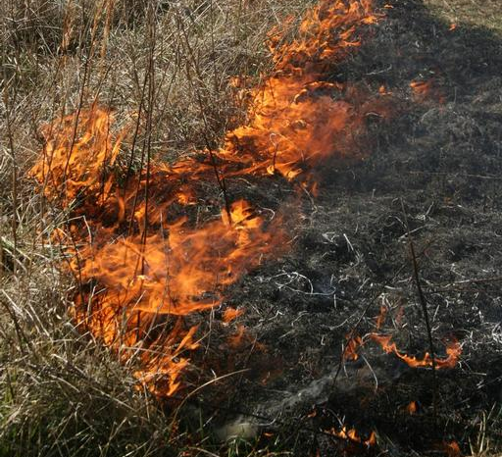
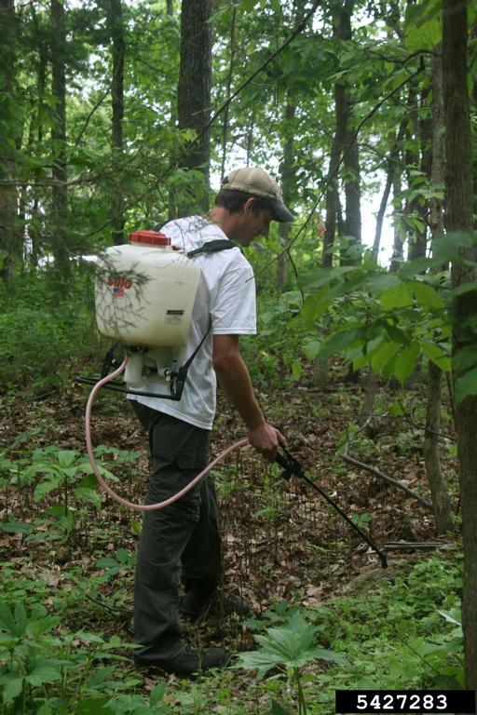
Forest Health Threats: Non-native Invasive Plant Control
Effective control using a combination of mechanical, cultural, and chemical control methods
Mechanical Controls: grinding, chipping, mowing, or bush hogging
Chemical controls: Using herbicides/pesticides to control invasive species (always read pesticide label, and follow label instructions)
Cultural control: prescribed fire (fire can stimulate population expansion for some species, therefore this technique should often be used in combination with mechanical and chemical techniques)
Image Description: A forest manager using a backpack sprayer to control invasive plants with herbicide.

Slide 19
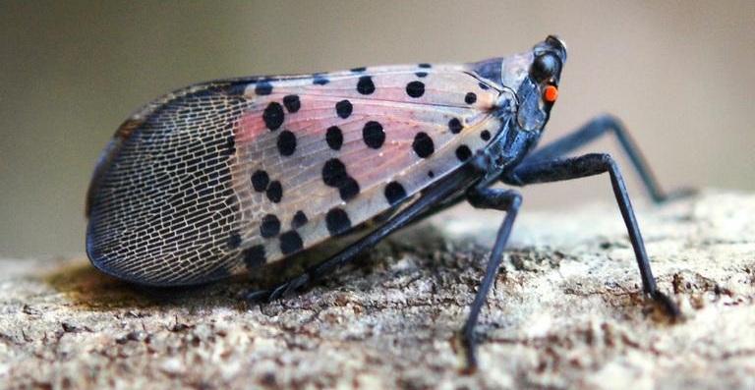
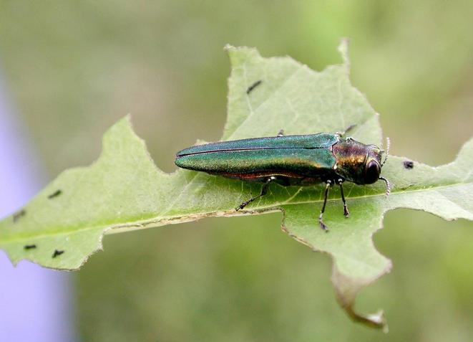
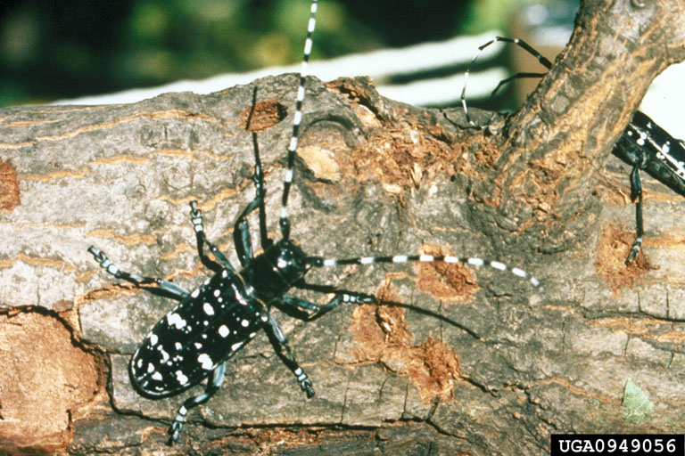
Forest Health Threats:
Non-native Invasive Insects
(Top) Spotted Lanternfly - Found in Pennsylvania (not yet found in Illinois)
(Bottom Left) Emerald Ash Borer - Prevalent throughout much of Illinois, spreading southward
(Bottom Right) Asian Longhorn Beetle – Has been found in northern Illinois
© Lawrence Barringer, Bugwood.org
© Debbie Miller, Bugwood.org
© Kenneth R. Law, Bugwood.org

Slide 20
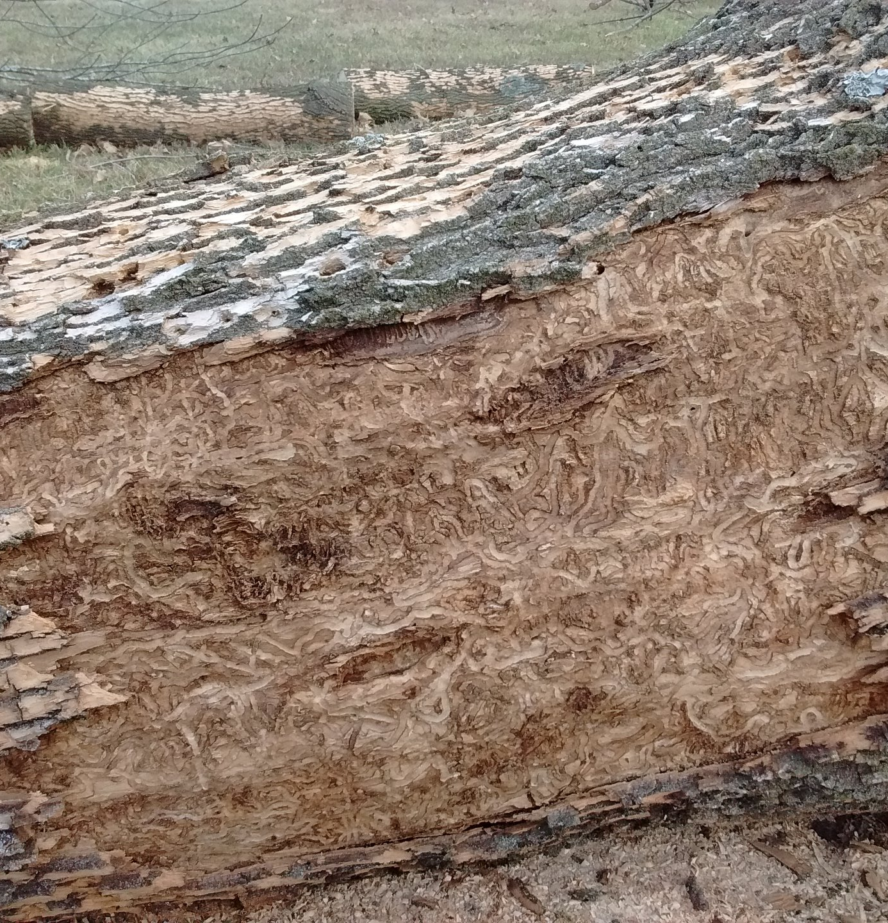
Non-native Invasive Insects: Emerald Ash Borer
Image Description:
S-shaped larval galleries left behind by EAB larvae in the cambium of an ash tree.
Emerald ash borer is expected to kill and remove most of the ash trees from urban environments, as well as our forests
Larvae from emerald ash borer disrupt nutrient flow throughout ash trees
Trees decline and die as quickly as 2-3 years
Infected trees should be considered hazardous, since infected trees lose structural integrity quickly ( falling limbs, entire tree etc.)
Symptoms include branch dieback, loss of foliage, bark splitting, woodpecker damage, D-shaped exit holes, blonding, epicormic shoots, and S-shaped larval galleries beneath bark

Slide 21
How to Prevent Spread of Non-native Invasive Insects
Be aware of pests in your area and act in accordance with any regulations or quarantines to prevent spread
Avoid transporting pests through firewood, lumber, vehicles, fruits or vegetables, plants, or furniture
Report any suspicious sightings of pests or symptoms to a professional land manager, or your local USDA APHIS office
Clean boots, tires, and equipment after leaving areas that contain pests

Slide 22
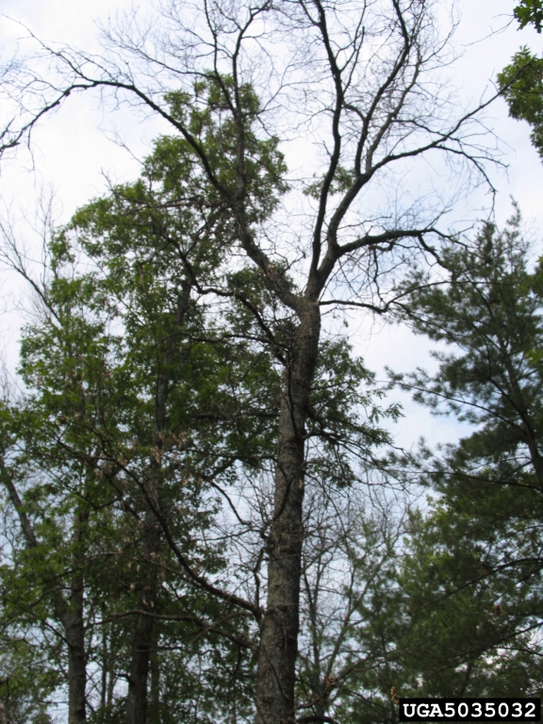
Forest Health Threats: Pathogens – Oak Wilt
Caused by the fungus Ceratocystis fagacearum
Found throughout Illinois
Invades water conducting vessels of the sapwood through fresh wounds and root grafts
Blocks flow of water between roots and foliage
Red oak group can defoliate in 4-6 weeks and do not recover
White oak group can take 1 year or more to defoliate, and have been known to recover, but usually die slowly
No cure, but spread can be controlled through the use of proper care, mechanical, and chemical control methods
Image Description: An oak tree suffering from oak wilt.
© Joseph Obrien, USDA Forest Service, Bugwood.org

Slide 23
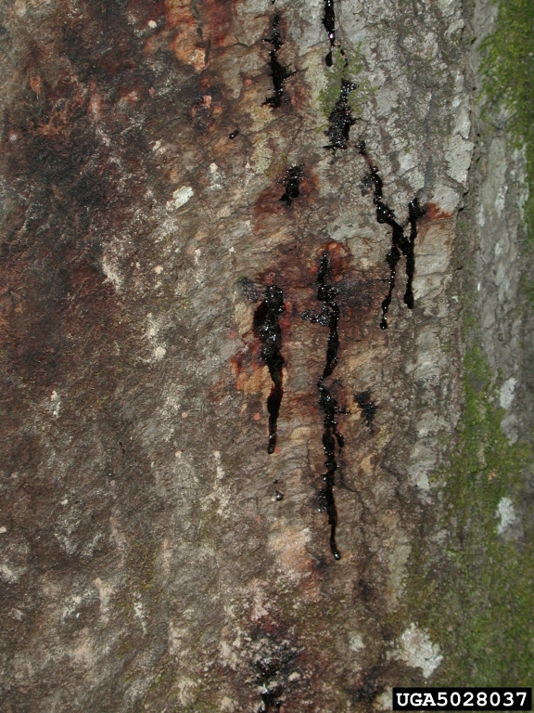
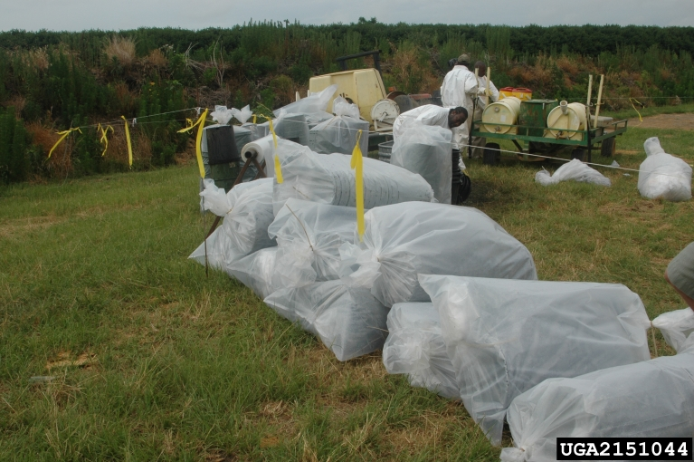
Forest Health Threats: Pathogens - Sudden Oak Death
© Bruce Moltzan, USDA Forest Service, Bugwood.org
Image Description: Bleeding cankers
Caused by the water mold (oomycete) Phytophthora ramorum
Infects plants across a large taxonomic range
Affects phloem in oaks, causing bleeding cankers
Can kill individuals in a few seasons after infection
Disease is incurable at this point
Only red oak group susceptible
If break out occurs, could be devastating to Illinois forests and urban forests
Image Description: Quarantine measures to dispose of infected plant material.

Slide 24
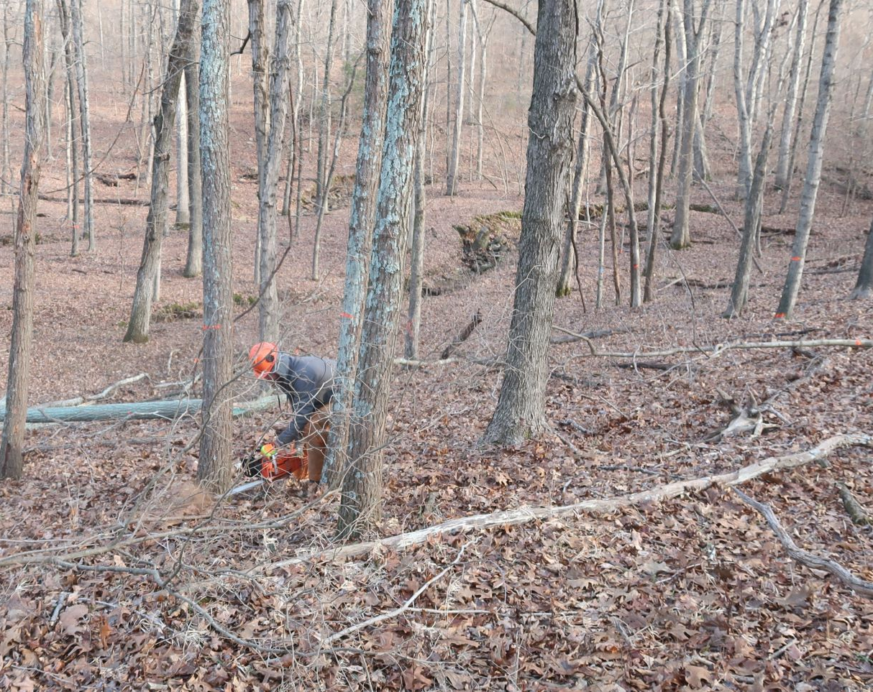
Forestry Professional Staff are too Few
Early retirement and subsequent budget cuts to IDNR have reduced Forestry Division professional, technical, and clerical staff by as much as 86%
Strategic planning dating back to the 1990’s, prior to staff loss, defined the need for additional districts and urban and traditional forestry field staff
Lack of access to state forestry professionals, seriously affects Illinois residents who own forested property.

Slide 25
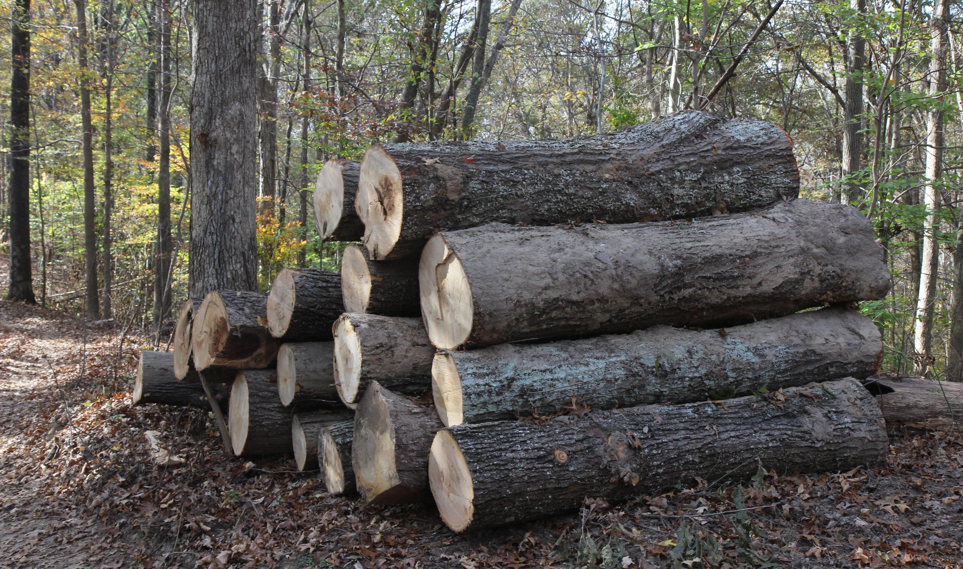
Forest Industries and Mills are too Few
The number of sawmills within Illinois has decreased by 72% since 1961
Partly attributed to higher workers compensation rates, utility rates, and business taxes compared to neighboring states
Currently almost 1/3 of round-wood harvested in Illinois is sent to other states for processing
A 2012 economic impact study authorized by the IFDC and conducted by Mississippi State University showed that forestry and forest products in Illinois represent $23 billion dollars in annual value

Slide 26
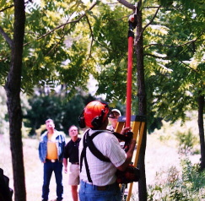
Urban and Community Forests Face Extreme Pressures and Challenges
Since 1990, there has been a 7% increase in municipal lands state-wide
Increased urbanization is outpacing reforestation efforts and the ability of most communities to manage urban forests
The benefits of trees, forests, and other green infrastructure contribute to the quality of life in all Illinois communities
There is a substantial need to further practices and policies which can sustain and improve urban forests
Shortages of technical staff/expertise, financial assistance for communities, and up to date information/materials for education
Image Description: An urban forester using a pole saw to prune a tree.

Slide 27
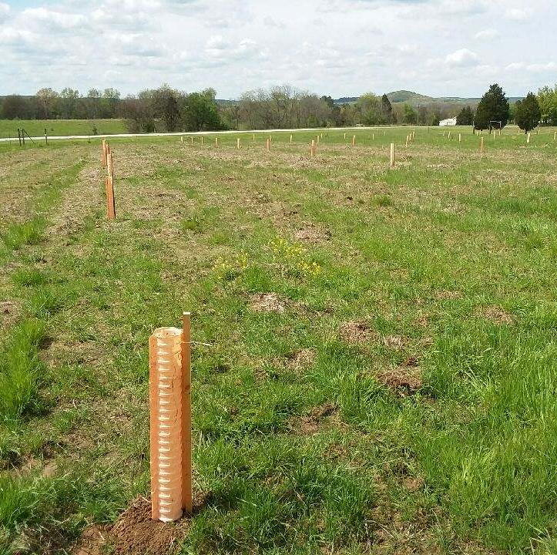
Forestry Funding and Significant Other Threats
Illinois has failed to generate or legislate permanent funding for forest and natural resources conservation and remains in great need of doing so
Reforestation and afforestation in Illinois is needed
The state once contained 14 million acres of forest, but now only contains 5 million acres.
There is a need for native plant material due to budgetary restraints to the IDNR Forest Nursery Program
Image Description: A Tree planting in Pope County, Illinois.

Slide 28
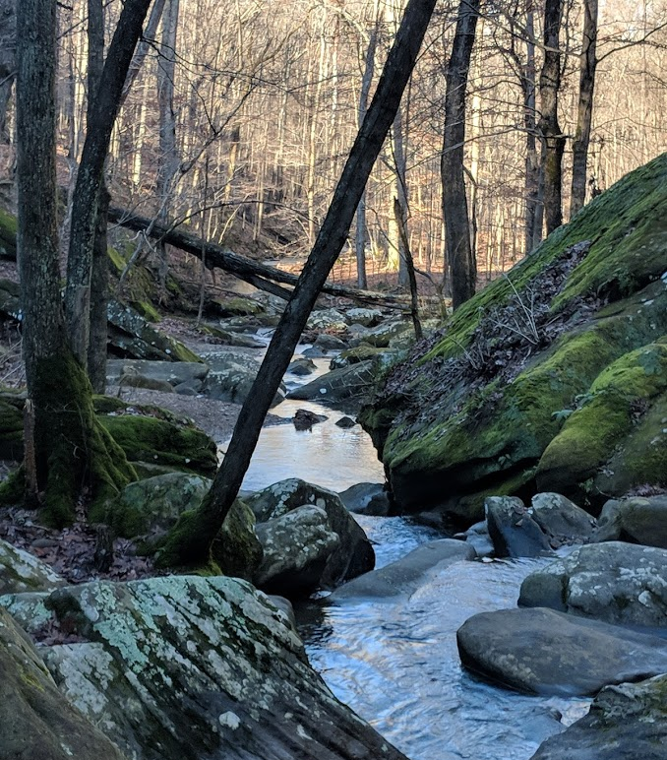
Forest Resource Strategies and Actions
Save and Expand Oak-hickory Forests
Create More Forested Areas of 500 Acres or More
Mitigate Forest Health Threats
Hire More Forestry Professionals
Expand on Illinois Forestry Industry
Expand Urban and Community Forests
Identify Permanent Funding for the State Forestry Division

Slide 29
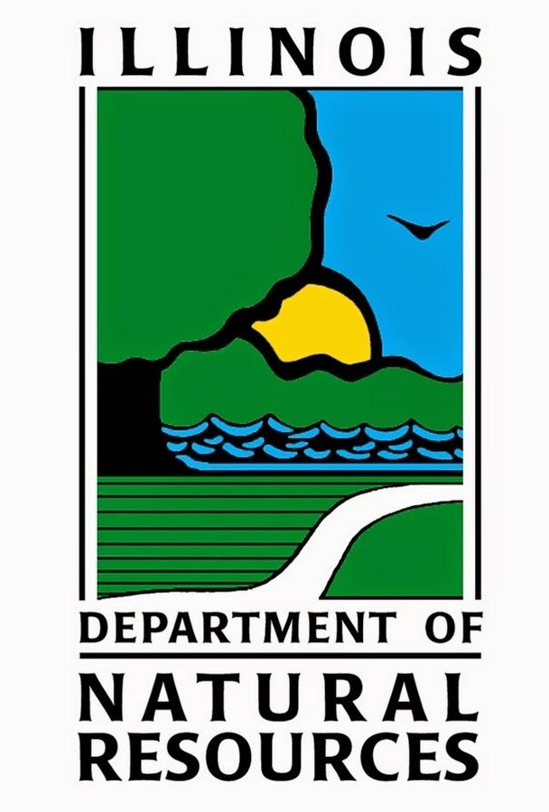
Resources for Forestry Management: Illinois Department of Natural Resources
“It is the mission of the Illinois Division of Forest Resources to protect, perpetuate, restore, conserve, and manage the forest and related resources of Illinois, both public and private, rural and urban; and to ensure for future generations the greatest economic, scientific, and social benefits that can only be provided through a forest ecological system”.

Slide 30
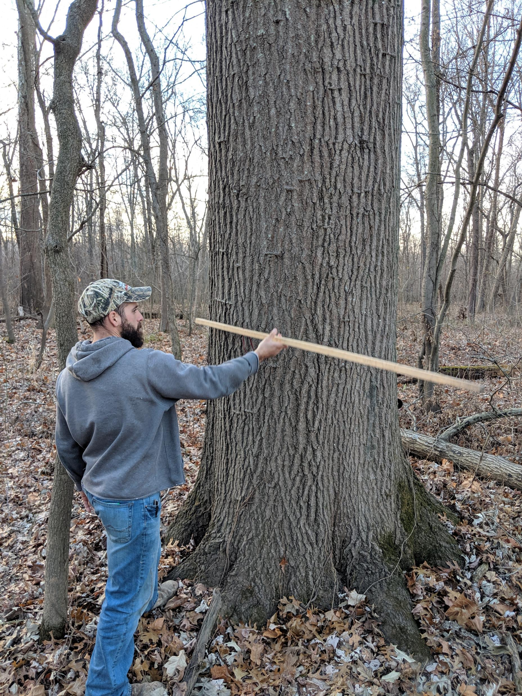
Illinois Department of Natural Resources: FDA Program
Forestry Development Act Cost Share Program – This program encourages private landowners to establish and manage their forested land
Timber growers participating in this program may be eligible for cost share
Property tax incentives for participation in this program
Requires developing a forest management plan for private landowners’ properties (often carried out by consulting foresters)
Forest management plans analyze forests by taking inventory of species present, tree density, soils, wildlife use, and other factors
Image Description: A forester taking tree measurements to analyze a forest.

Slide 31
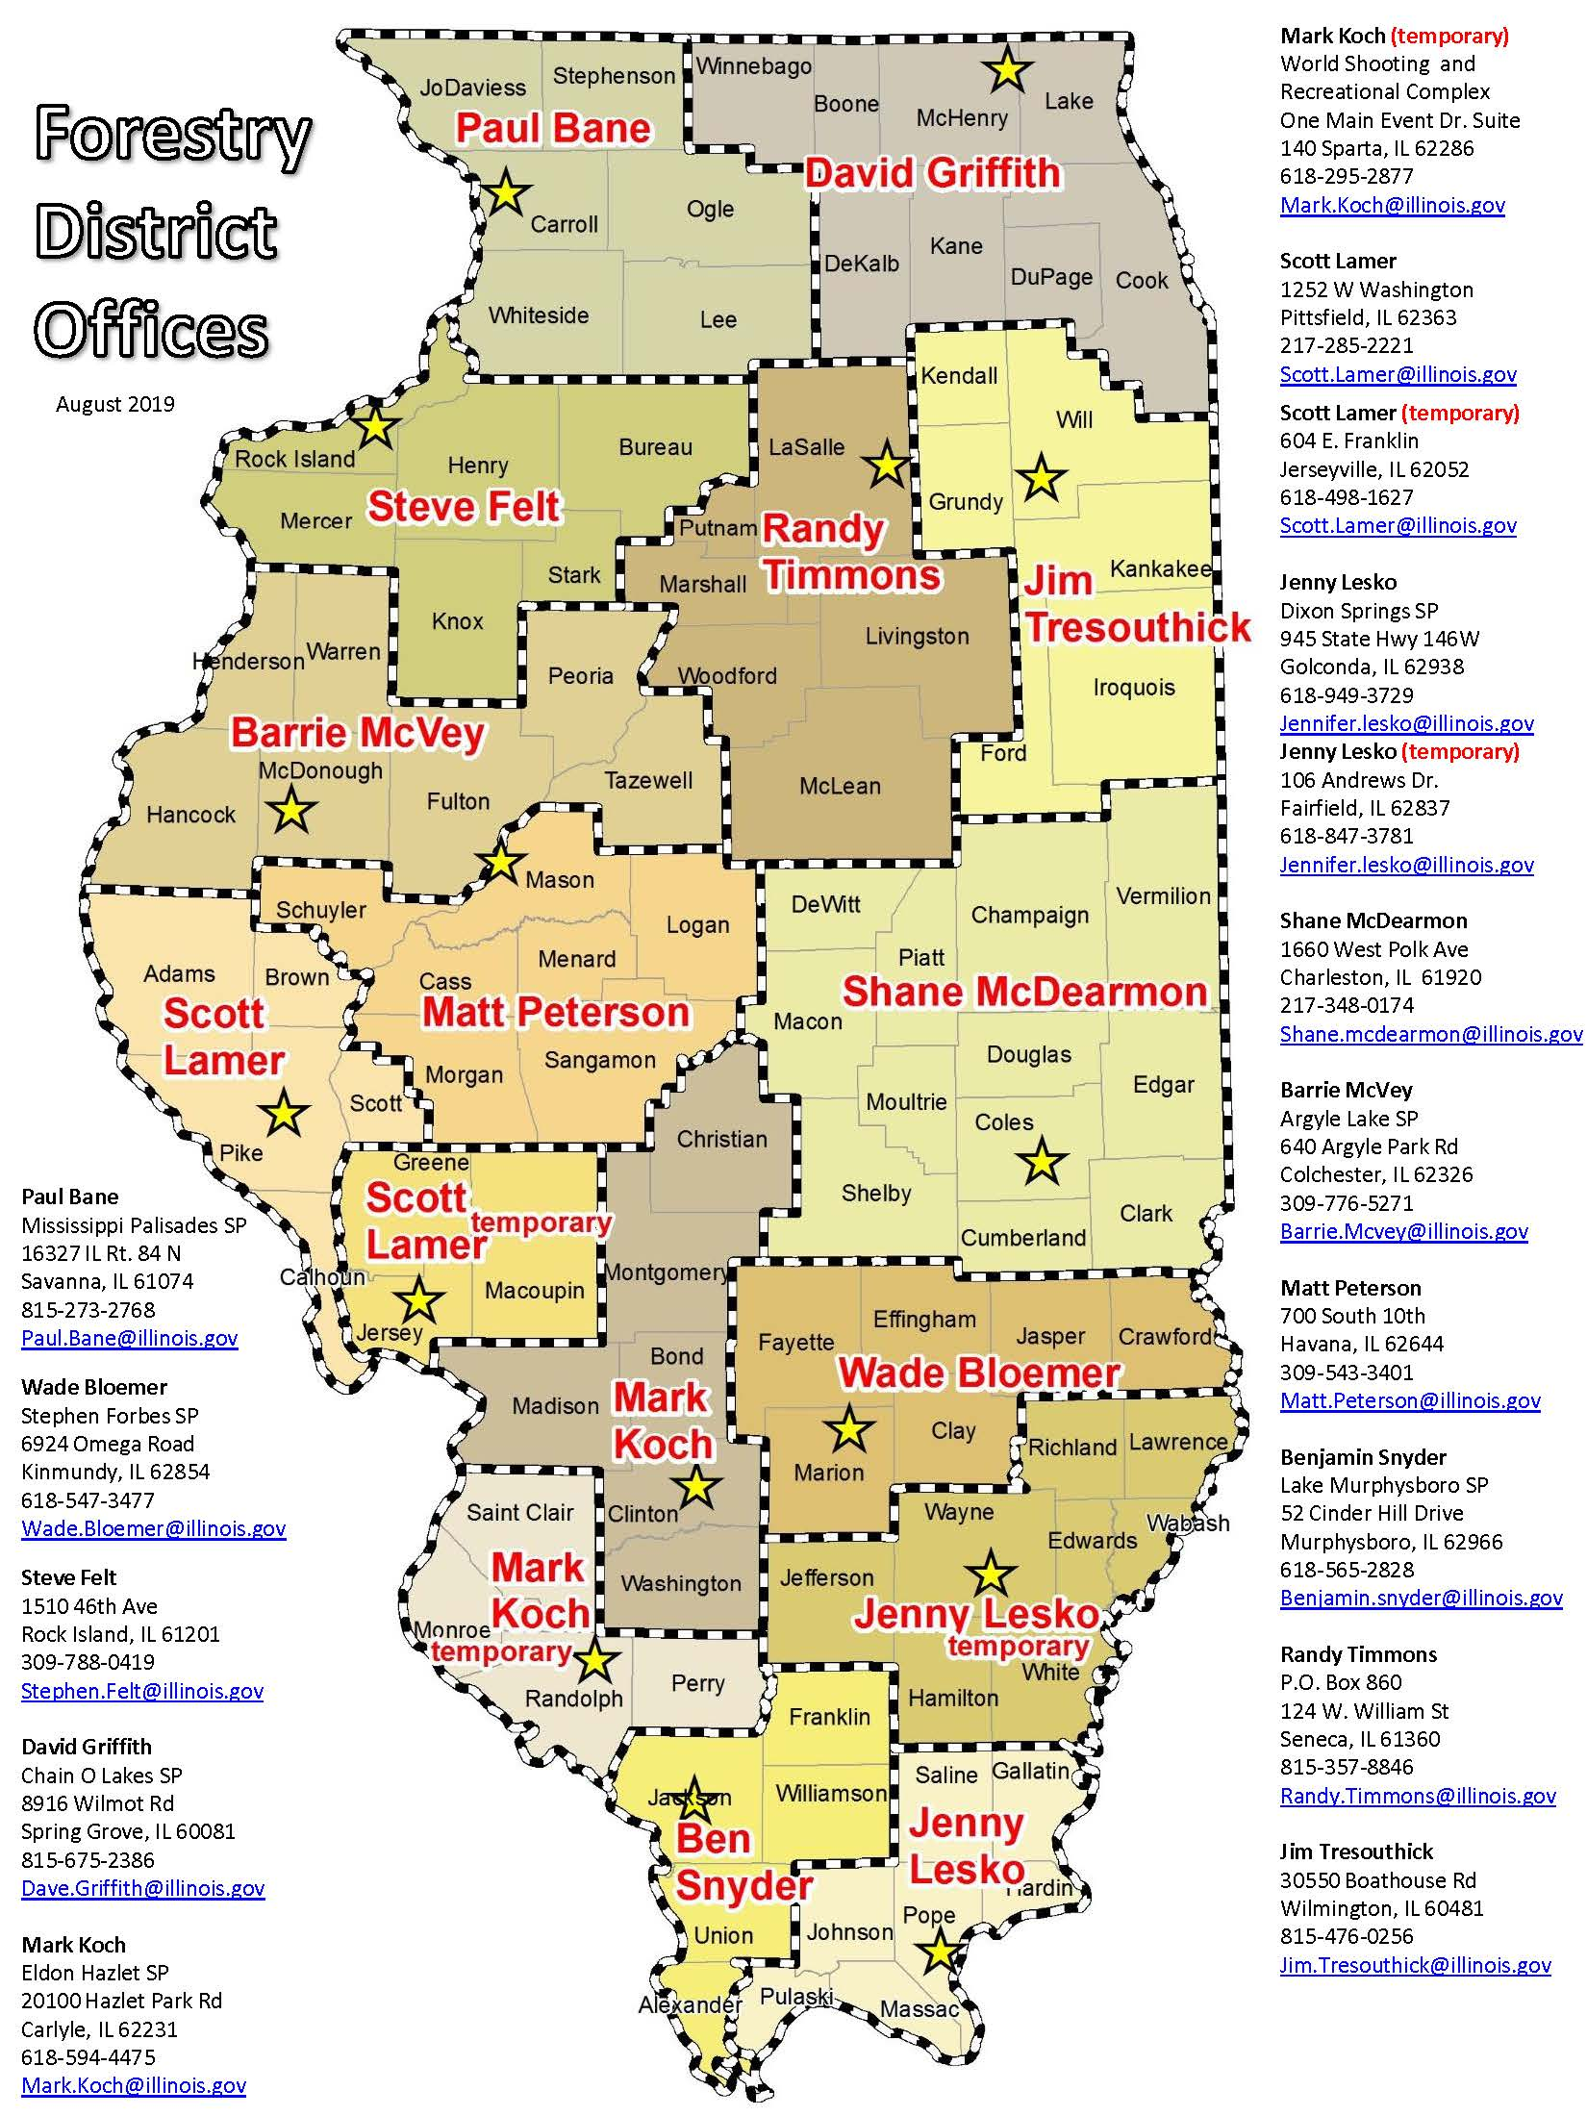
Illinois Department of Natural Resources: District Foresters in Illinois
Technical Assistance Provided by District Foresters:
● Forest Reconnaissance
● General Forest Planning
● Woodland Inventory and Analysis
● Forest Management Plan Development
● Timber Sales & Timber Harvesting Assistance
● Forest Management Recommendations
● Forest Plantation Maintenance and Recommendations
● Forest Health Recommendations (Insects & Disease)
● Tree Planting Plans and Recommendations
● Forestry-related USDA CRP/CREP/EQIP practices
● Herbicide Recommendations
● Illinois Tree Farm™ Program Certification
● Forest Wildlife Management Recommendations
● Urban and Community Forestry Plannin

Slide 32
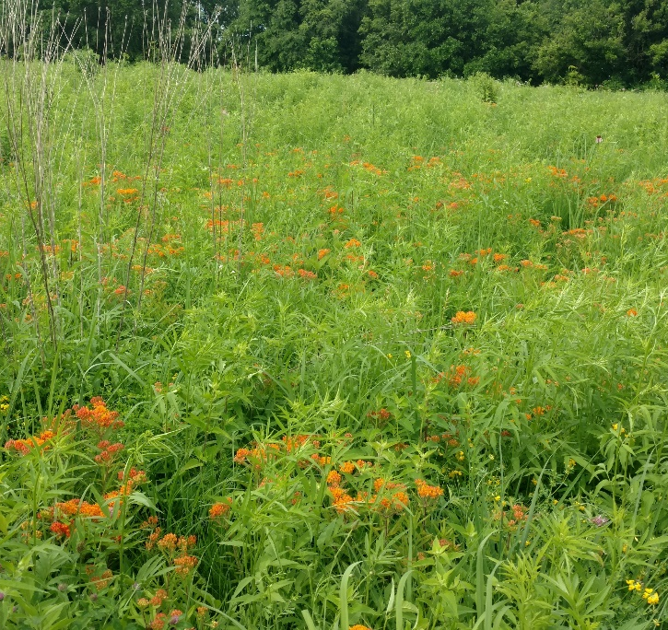
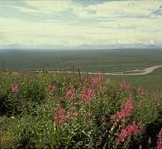
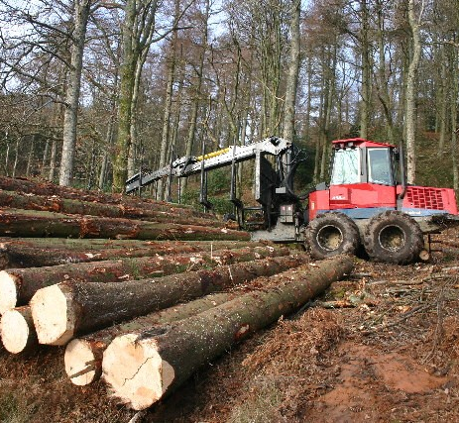

USDA Natural Resources Conservation Services
Programs to help private landowners with their forested acres
1.) Conservation Reserve Program (CRP)
2.) Environmental Quality Incentives Program (EQIP)
3.) Conservation Stewardship Program (CSP)
4.) Agricultural Conservation Easement Program (ACEP)

Slide 33
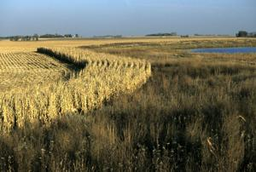
USDA Natural Resources Conservation Services: Programs to Assist Private Landowners
Conservation Reserve Program (CRP) – This program is ideal for steep and highly erodible land, establishing wildlife habitat, and tree planting/ forestry as well. Visit your USDA Service Center to check eligibility, discuss what you want to do, and consider signing up for a 10- to 15-year contract. CRP offers landowners payments to take care of contracted acres in a conservation-minded manner.

Slide 34
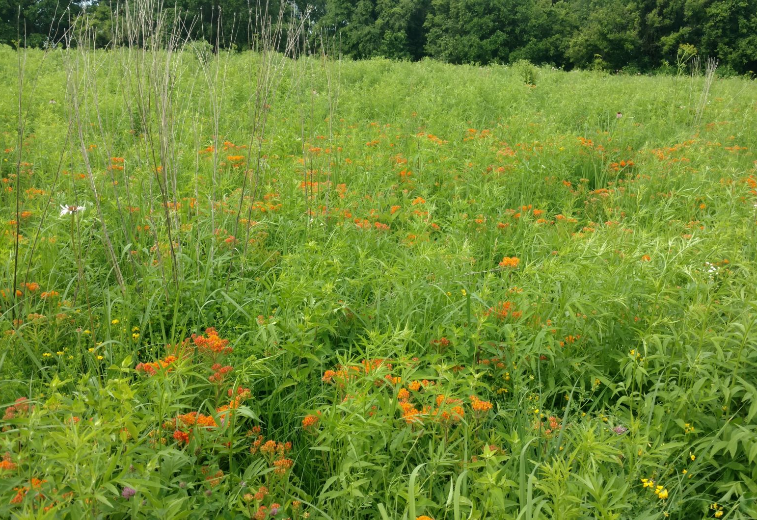
USDA Natural Resources Conservation Services: Programs to Assist Private Landowners
Environmental Quality Incentives Program (EQIP) – This program is designed to help ag cropland and forest landowners fix resource concerns on their land caused by water, erosion, and other issues that degrade the land. NRCS staff can discuss your issues, create a conservation plan to address them, and provide designs and practices, as well as funds to fix them.

Slide 35
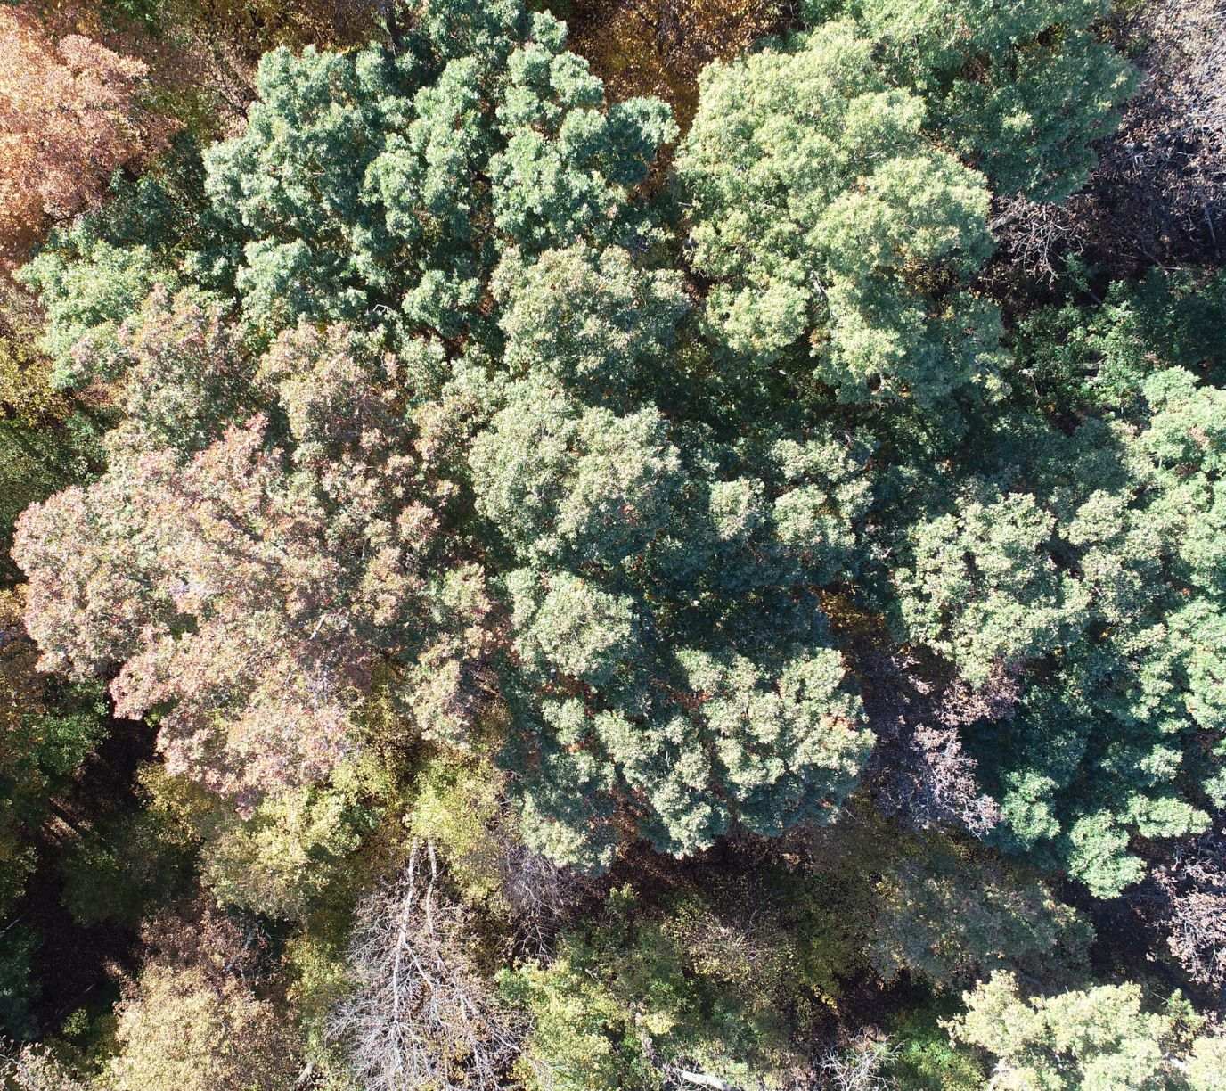
USDA Natural Resources Conservation Services: Programs to Assist Private Landowners
Conservation Stewardship Program (CSP) - This is a five-year contract option that offers the same NRCS technical assistance and an annual incentive payment to install conservation practices and enhancements specifically suited to non-industrial forest land. CSP works well on forested acres and helps cover land improvements on your entire ag operation.

Slide 36
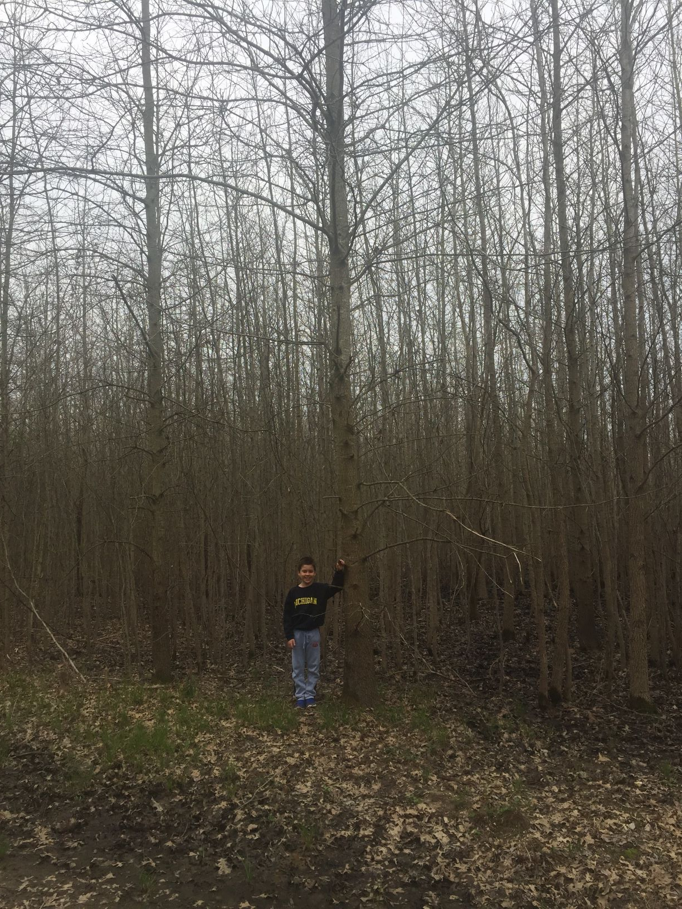
USDA Natural Resources Conservation Services – Programs to Assist Private Landwners
Agricultural Conservation Easement Program (ACEP’s) Wetland Reserve Easement (WRE) - This is the new version of the former Wetland Reserve Program (WRP). This program is perfect for private land that is often flooded and unable to be farmed. These acres are restored back to their natural condition, which is often trees. Through this program, NRCS purchases a conservation easement in order to manage, maintain, and protect those acres. With easements, you can lock land into a protected status for 30 years, or forever. Conservation easements are a great way to make a lasting commitment to the land you love and a way to leave a legacy for your kids and grandkids.

Slide 37
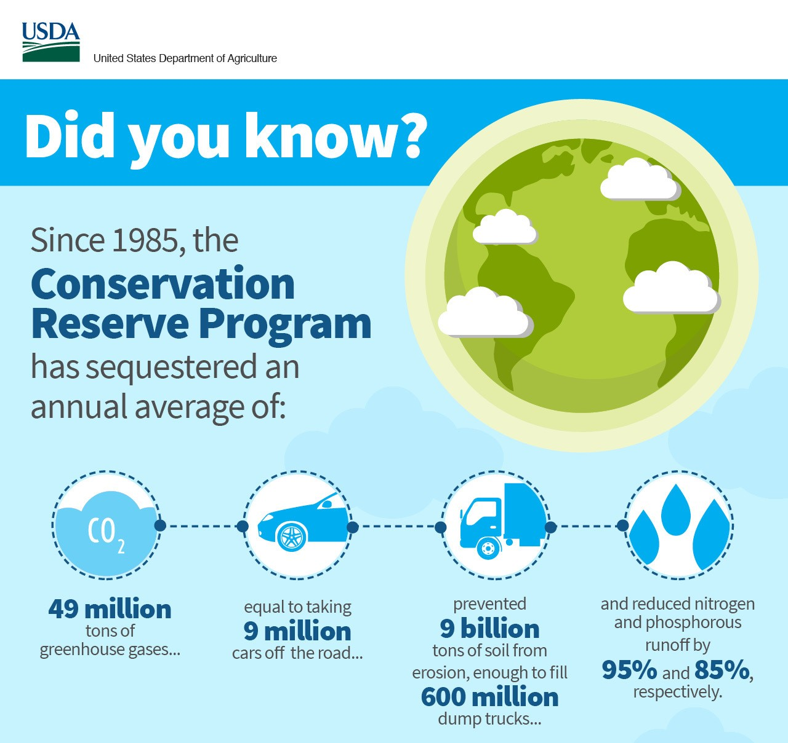
Great program for steep and highly erodible land
Establishes wildlife habitat
Also encourages tree planting and forestry

Slide 38

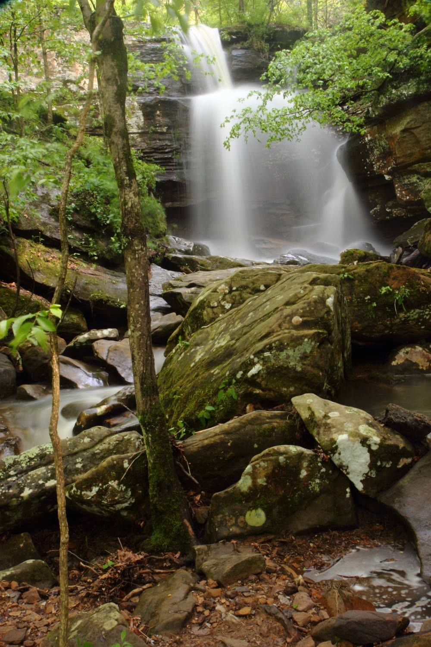
Resources for Forestry Management: USDA Forest Service
Their mission: “To sustain the health, diversity, and productivity of the Nation’s forests and grasslands to meet the needs of present and future generations”.
Work in collaboration with communities and partner agencies and organizations
Connect people to the natural world
Excellent resource for forest management

Slide 39
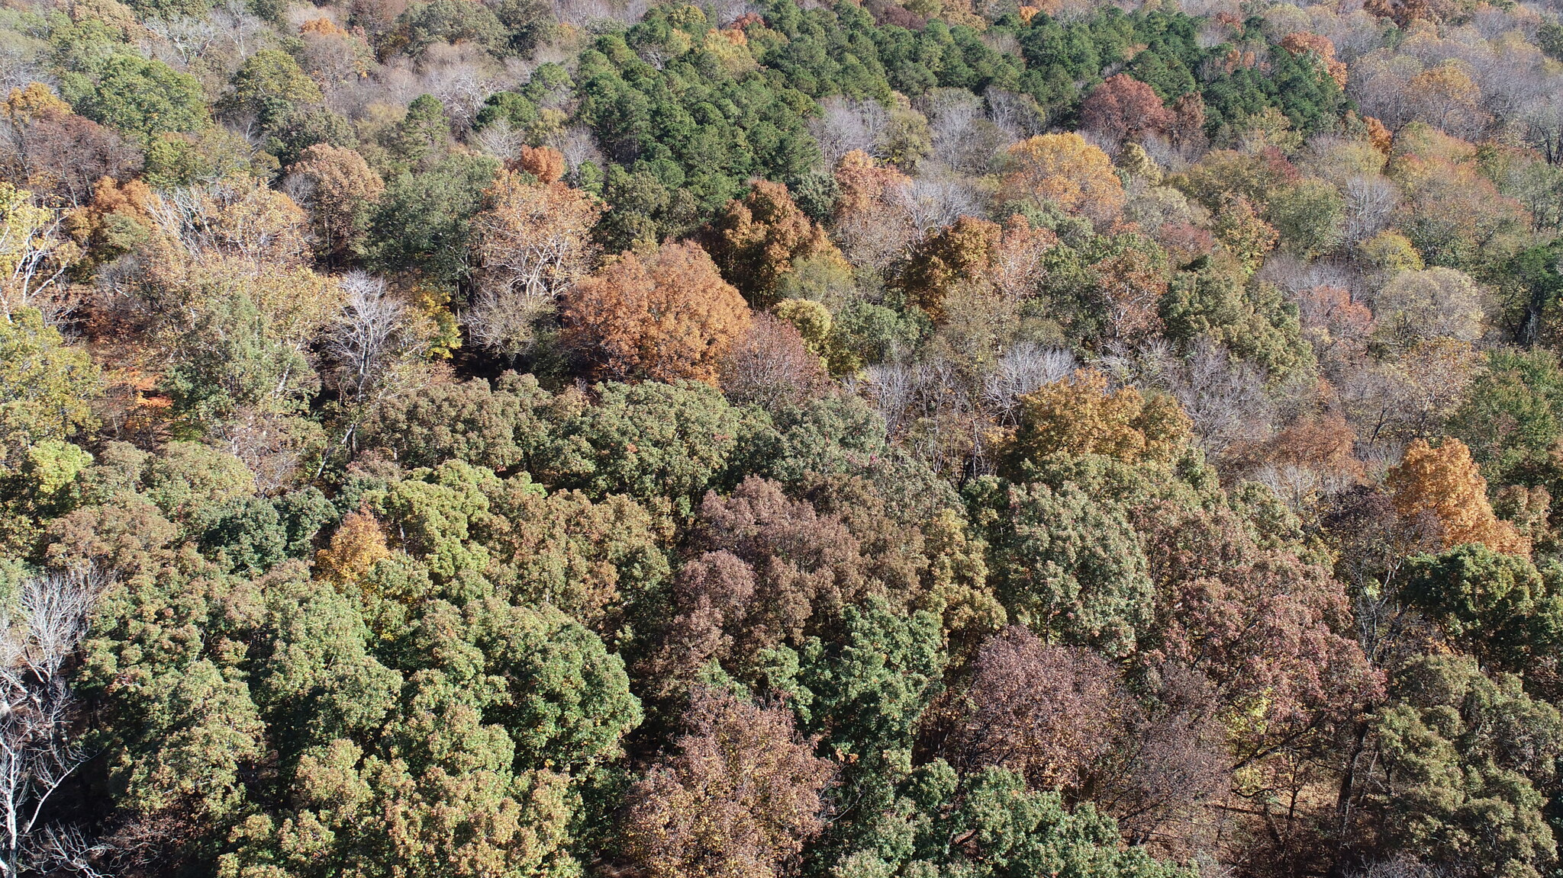
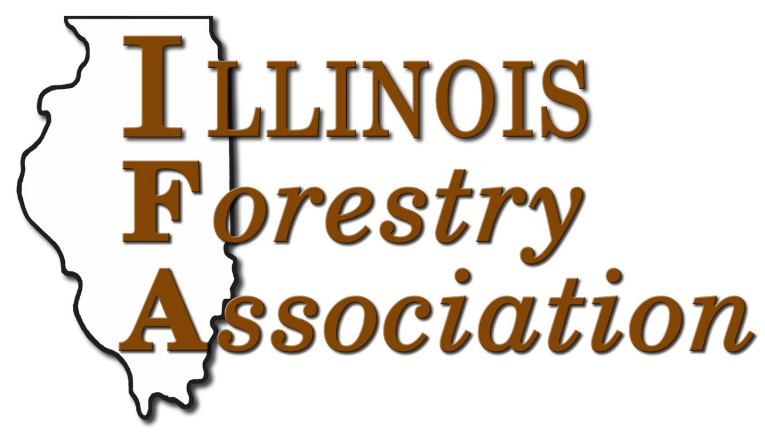
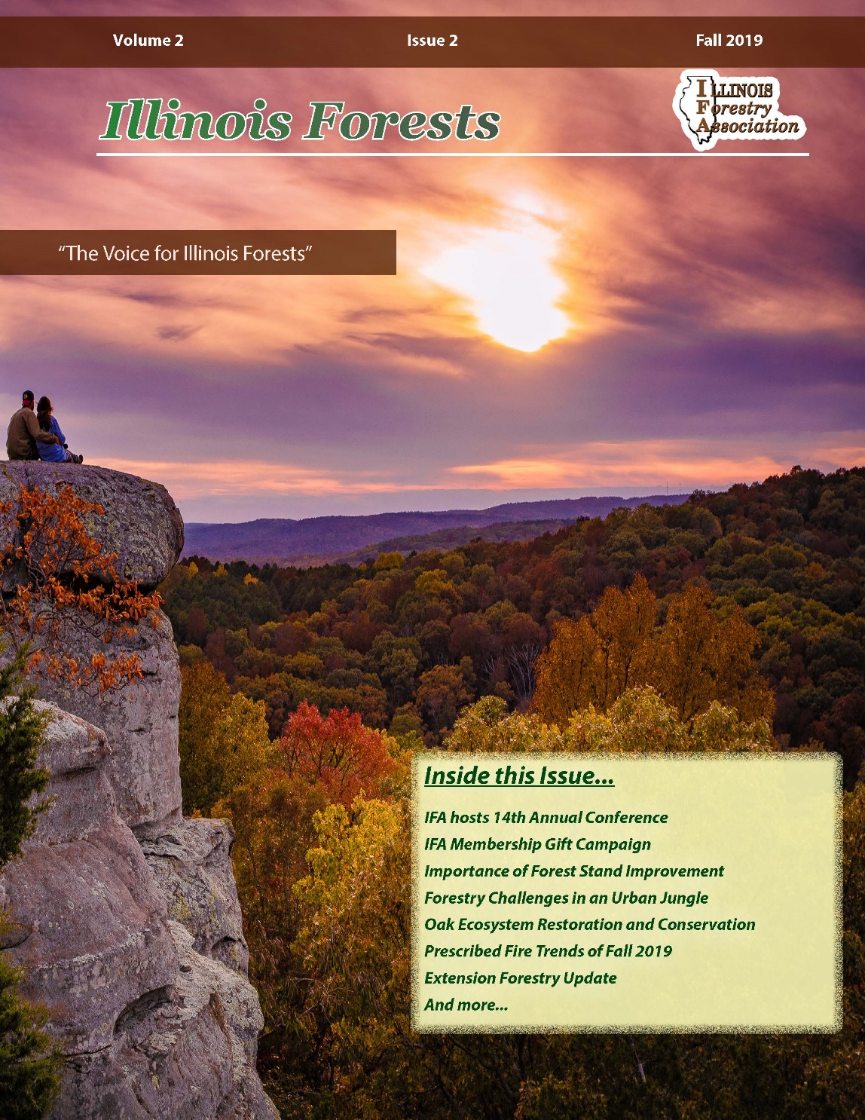
Resources for Forestry Management: Illinois Forestry Association
Provide educational outreach to private landowners about responsible forest management
Connect landowners to the resources they need to manage their forests
Quarterly newsletters, website, field days, annual meeting

Slide 40
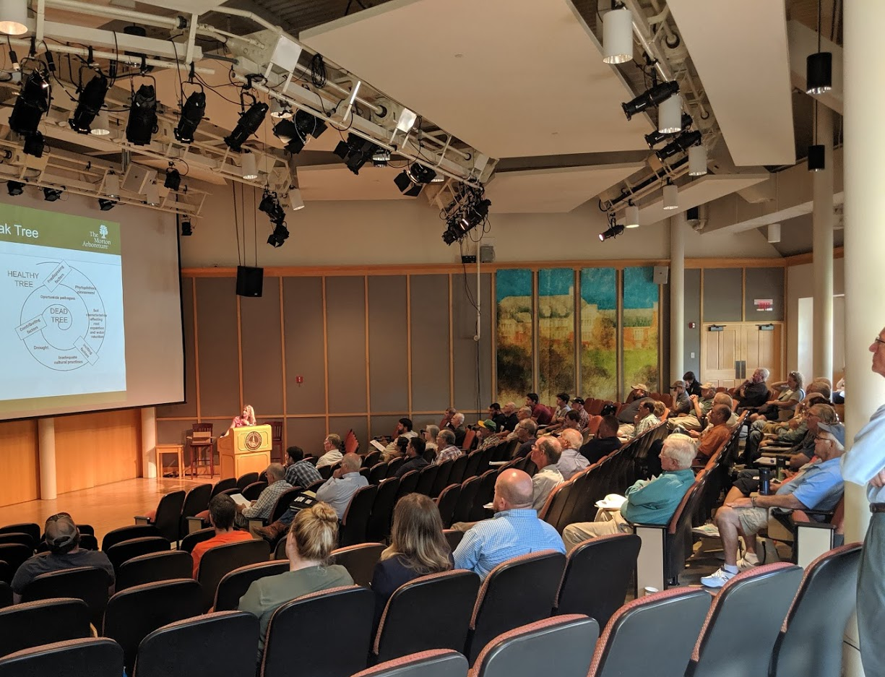

Illinois Forestry Association

Slide 41


Resources for Forestry Management:
Illinois Tree Farm
The Illinois Tree Farm Program promotes the growth of renewable forest resources while protecting environmental resources
Outreach to increase public understanding of the benefits of productive forestry
Programs to educate and connect tree farmers

Slide 42
Resources for Forestry Management: Illinois Walnut Council
An international association founded in 1970
Represent nearly 1,000 forest owners, foresters, forest scientists, and wood-producing industry representatives in 45 states.
Objectives
1.) To advance cultural practices, and transfer science and technology to field practices.
2.) Encourage good forest management and sustainability of existing timber
3.) Encourage new planting of walnut and other tree species
4.) Sponsor state chapters and other events of interest to tree growers
5.) Assist foresters to keep current with up to date research and industry information

Slide 43


Resources for Forestry Management: Illinois Chapter – Society of American Foresters
“The Illinois Society of American Foresters set the standard in forest management, bringing science, best practice, and the best people together to shape the future of the profession”.
A non-profit organization founded by Gifford Pinchot in 1900.

Slide 44


Resources for Forestry Management: Illinois Chapter – The Wildlife Society
Founded in 1937
An international non-profit scientific and educational association dedicated to excellence in wildlife stewardship through science and education.
Objectives –
1.) Develop and promote sound stewardship of wildlife resources and the environments upon which wildlife and humans depend
2.) Undertake and active role in preventing human-induced environmental degradation
3.) Increase awareness and appreciation of wildlife values
4.) Promote the highest standards in all activities of the wildlife profession

Slide 45


Resources for Forestry Management: Illinois Arborist Association
A non-profit organization that educates members about proper tree care.
Their goal is to foster interest, establish standards, exchange professional ideas and to pursue scientific research in arboriculture
A state-wide partnership of people and programs to enhance and protect the career investment of professional foresters.
News and information on issues affecting tree care throughout Illinois through a quarterly newsletter
Arborist testing/certification, training workshops

Slide 46

Resources for Forestry Management: Association of Illinois Soil and Water Conservation Districts
Grass roots organization formed in 1948
Serves Illinois’ 97 member soil and water conservation districts
Work to protect Illinois’ fertile soils and water resources through strategic conservation efforts
Play a central role in efforts to protect and sustain the viability of Illinois’ natural resources for future generations

Slide 47


Resources for Forestry Management: University of Illinois - Natural Resources and Environmental Sciences
This department brings biological, physical, and social scientists together to identify, teach, and publicize solutions for the sustainability of urban, managed, and natural ecosystems from the local to global scale.
Research on cutting edge technology and methodology for responsible forest management
Workshops on numerous land management topics

Slide 48


Resources for Forestry Management: Southern Illinois University Carbondale Dept. of Forestry
Excellent resource for prospective students interested in the field of forestry
One of 47 nationally accredited Bachelor of Science programs by the Society of American Foresters
Fascinating research spanning many subjects in forest and resource management

